Slide 1
CRM analysis Presented by Kumara swamy Mj (Scaler capstone project)
Project Overview:
The project involves analysing transactions data from a UK-based non-store online retail business specializing in unique all-occasion gifts. The dataset spans from December 2010 to December 2011 and includes information such as invoice numbers, product codes, descriptions, quantities, dates, prices, customer IDs, and countries. Negative quantities denote return transactions, while zero-unit prices suggest free items. The goal likely revolves around understanding customer behaviour, sales patterns, and potentially optimizing business strategies such as inventory management and marketing efforts.

Slide 2
Data Insights Overview
Sales Analysis by Country
United Kingdom: - Total Orders: 299,750 - Total Sales: £3,669,450.23 - Total Quantity: 2,153,681
Top Selling Products –
PARTY BUNTING: - Total Orders: 1,268 - Total Sales: £34,952.85 –
WHITE HANGING HEART T-LIGHT HOLDER: - Total Orders: 1,668 - Total Sales: £31,763.76
Customer Demographics - Total Customers (UK): 299,750 - Total Customers (Foreign): - Germany: 7,439 - France: 6,882
Top Customers Analysis –
Highest Sales: - CustomerID: 14911.0 - Sales: £84,635.89 - Quantity: 49,350
Highest Quantity: - CustomerID: 14911.0 - Sales: £84,635.89 - Quantity: 49,350
ARPU Analysis - Average Revenue Per User: - Highest ARPU - CustomerID 16716.0 ARPU - £ 166.80
Top customer ARPU CustomerID: 14911.0 - ARPU: £18.93 - CustomerID: 14096.0 - ARPU: £8.16
RFM Segmentation Analysis- Mean Values - Can't Loose Them: - Recency: 26.3 days - Frequency: 11.2 orders - Monetary Value: £2,020.6
This overview provides a snapshot of key insights from the dataset, including sales analysis, top products, customer demographics, top customers, ARPU analysis, and RFM segmentation.

Slide 3
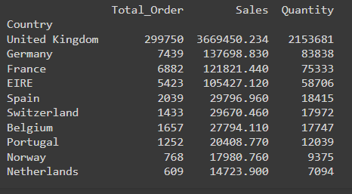
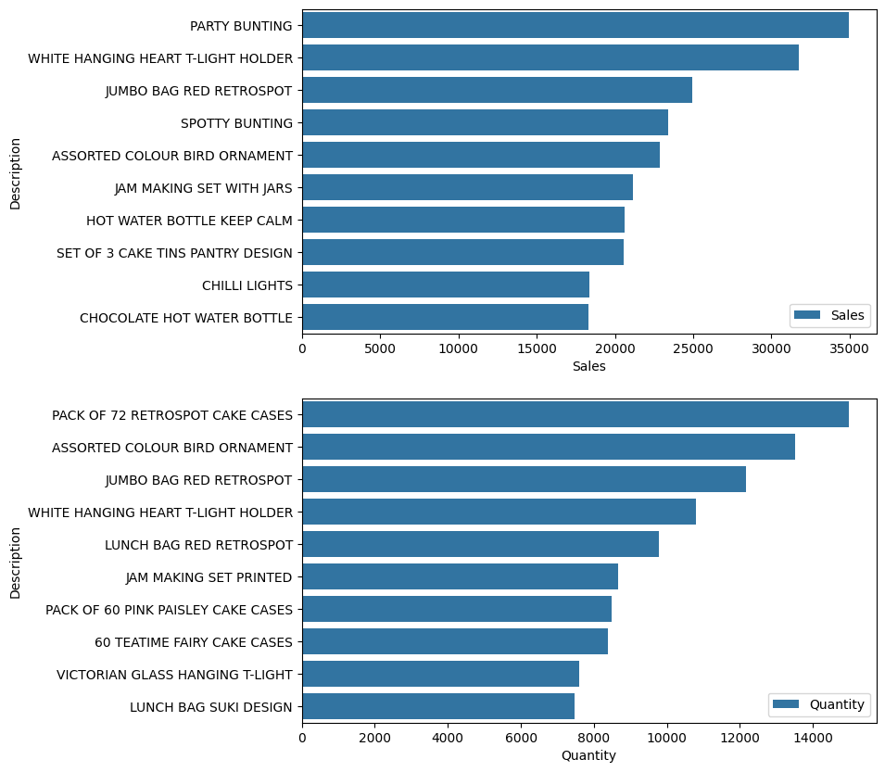
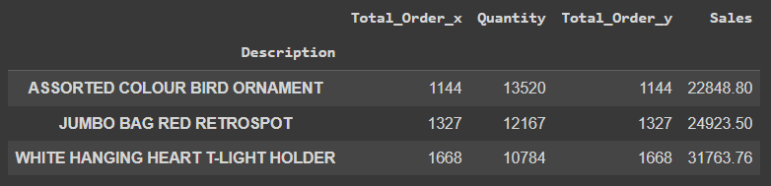
Top sales and top selling products
Insight: United Kingdom dominates sales, contributing significantly to total revenue.
Recommendation: Focus on leveraging success in the UK market to drive expansion efforts in foreign markets & Continue efforts to engage and retain UK customers through personalized marketing campaigns and loyalty programs.
Implement targeted marketing campaigns to attract and retain customers in high-potential countries like Germany, France, and EIRE. Explore opportunities to expand customer base in other countries by tailoring marketing efforts to local preferences and behaviours.
Insight: Higher quantity of sales does not guarantee the higher sales earned and There is only 3 products that have the highest quantity and sales out of total 3858 products
Recommendation: Allocate resources towards promoting top-selling products such as "PARTY BUNTING" and "WHITE HANGING HEART T-LIGHT HOLDER".
Consider bundling or cross-selling strategies to increase sales of related products.

Slide 4
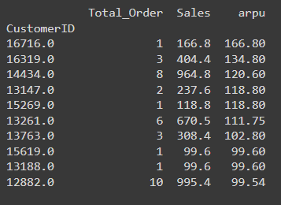
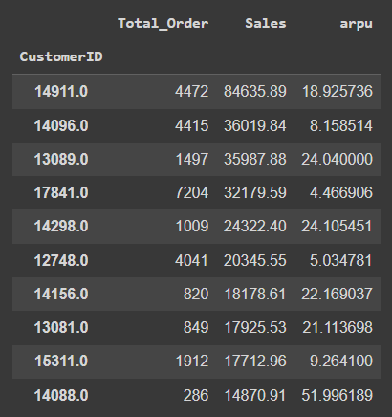
ARPU analysis
Top ARPU customers
Average Revenue Per User (ARPU) varies among customers.
Recommendation:
Identify opportunities to increase ARPU through upselling, cross-selling, or value-added services.
Develop targeted marketing campaigns to encourage higher spending among existing customers.
Top Customers and their ARPU

Slide 5
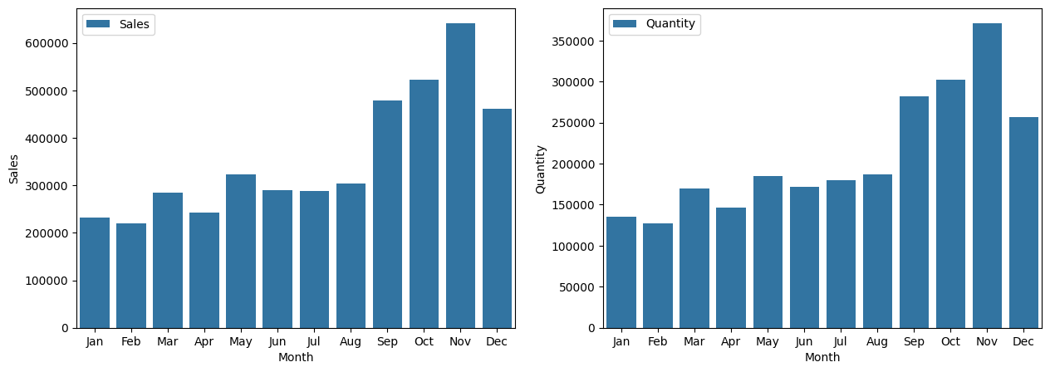
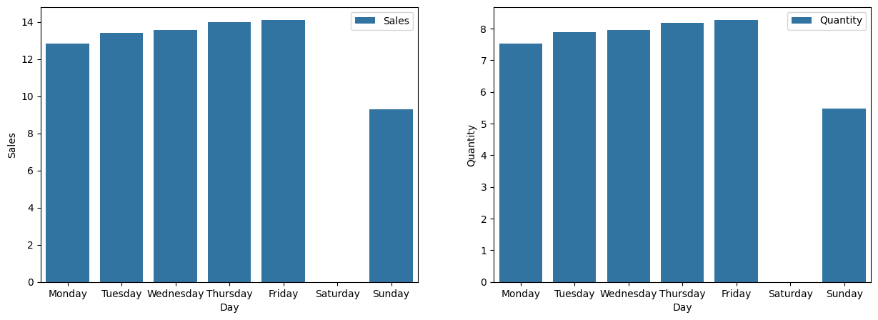
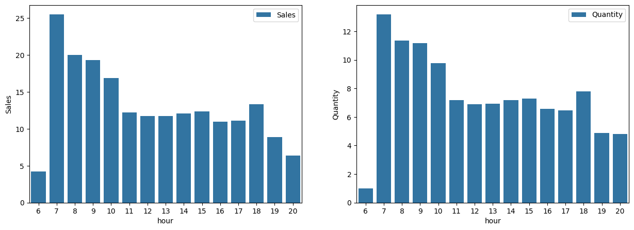
Best time
Growth trend observed since August, peaking in November 2011.
Friday emerges as the peak day for sales.
Most transactions occur during morning hours, specifically between 7-10 AM.
Saturday being weekoff it’s the best time to do the stocks refilling after a peak day
This analysis reveals the best times for sales, highlighting peak periods by month, day, and hour, aiding in strategic planning and resource allocation for maximizing revenue.

Slide 6
RFM Segmentation Analysis
Can't Lose Them:
Offer exclusive loyalty programs or VIP treatment to reinforce their importance.
Provide personalized recommendations and incentives based on their purchase history.
Ensure excellent customer service and support to maintain their satisfaction and loyalty.
Champions:
Acknowledge and reward their loyalty with special discounts, early access to new products, or freebies.
Encourage them to refer friends or family with a referral program.
Collect feedback and suggestions to further enhance their experience.
Demands Activation:
Targeted marketing campaigns to re-engage inactive customers.
Offer special promotions or discounts to incentivize repeat purchases.
Provide educational content or product guides to help them make informed purchasing decisions.
Loyal/Committed:
Maintain regular communication through newsletters or personalized emails.
Offer incentives for repeat purchases or higher order values.
Provide VIP treatment or exclusive access to events to strengthen their loyalty.
Potential:
Targeted promotions or discounts to encourage them to make more purchases.
Provide personalized product recommendations based on their browsing or purchase history.
Offer introductory offers or free trials to entice them to become more active customers.
Promising:
Provide excellent customer service to build trust and confidence in the brand.
Offer incentives or rewards for completing their first purchase or making additional purchases.
Implement targeted marketing campaigns to keep the brand top-of-mind.
Requires Attention:
Reach out with personalized emails or phone calls to address any issues or concerns they may have.
Offer special discounts or promotions to encourage them to make another purchase.
Gather feedback to understand why they may be dissatisfied and take steps to improve their experience.
RFM Level | RFM Score | Count of Customers
Can't Loose Them | >=9 | 1443
Champions | >=8 to 9 | 373
Loyal/Committed | >=7 to 8 | 414
Potential | >=6 to 7 | 415
Promising | >=5 to 6 | 415
Requires Attention | >=4 to 5 | 365
Demands Activation | <4 | 358

Slide 7
THANK YOU

